Slide 1
Reading and Writing Algebraic Expressions

Slide 2
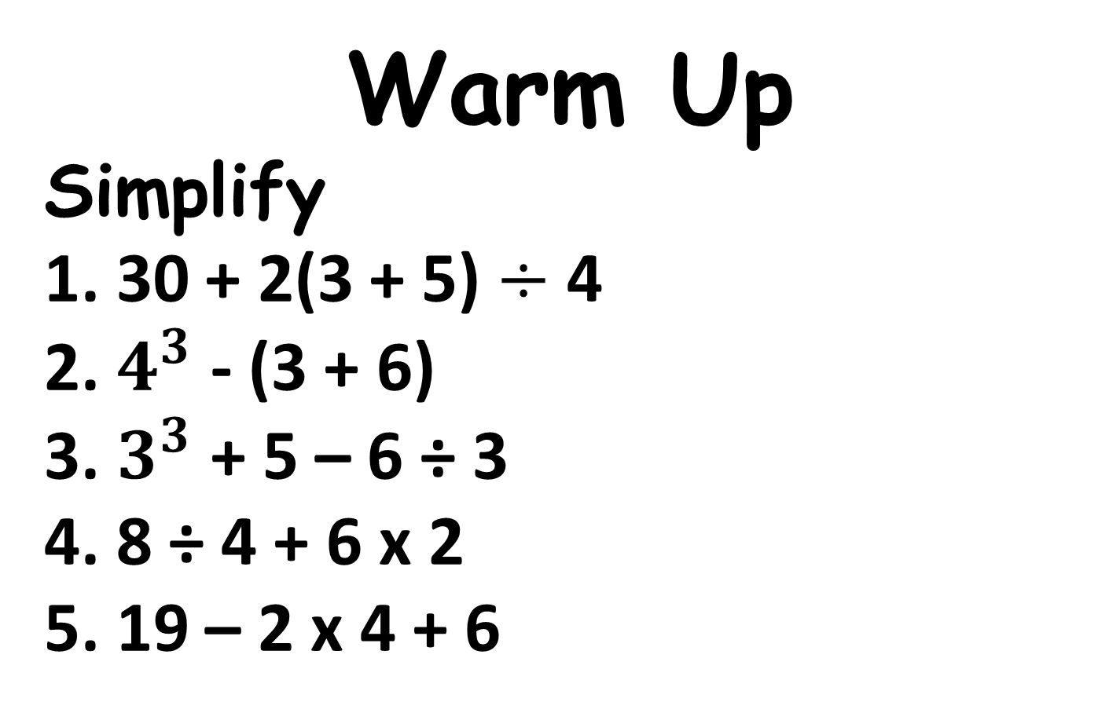
Warm Up
Simplify
1. 30 + 2(3 + 5) $÷$ 4
2. $4^{3}$ - (3 + 6)
3. $3^{3}$ + 5 – 6 ÷ 3
4. 8 ÷ 4 + 6 x 2
5. 19 – 2 x 4 + 6
34
55
30
14
17

Slide 3
A variable is a symbol, usually a letter, that stands for a number.

Slide 4
An algebraic expression consists of one or more numbers, variables and operations.
How is it different from a numeric expression?
It includes variables.

Slide 5
Examples of Algebraic Expressions
3x
4 + r
3d – 6 + 6f -7
This means 3 times x.

Slide 6
A term is a number and or variable separated by + and or – signs.
3x + 4y - 6 has 3 terms
Term 1
Term 2
Term 3

Slide 7
Coefficient – a number that is multiplied with a variable.
In the term 3x, 3 is the coefficient.

Slide 8
Copy the table on the next page.

Slide 9
Addition
Subtraction
Multiplication
Division

Slide 10
Put the words in the correct box.
Times
Product
Less than
Difference
Total
Quotient
Sum
Plus
More than
Increased by
Divided by
Less than
Decreased by

Slide 11
Addition
Subtraction
Plus
Difference
Sum
Total
Decreased by
More than
Increased by
Less than
Multiplication
Division
Product
Divided by
Times
Quotient

Slide 12
Can you think of more?

Slide 13
Example 1: Write the verbal expression for 7n – 4.
“Four less than seven times a number”
What is another way to write the expression?

Slide 14
Example 2: Write the expression for 5(d + 6).
“The product of 5 and the sum of a number and 6.”
What is another way to write the expression?

Slide 15
Example 3: Write an algebraic expression for “ 7 increased by 8.”
7 + 8

Slide 16
Example 4: Write an algebraic expression for “The quotient of 8 and 4.”
8 ÷ 4

Slide 17

Practice
Write a verbal expression.
r – 8
6x + 2
Write the algebraic expression.
3. f increased by 12
4. 13 divided by y
Possible answers
r decreased by 8
6 times x plus 2
f + 12
$$\frac{13}{y}$$

Slide 18
Closure
Write as many verbal expressions for 2x + 5 as you can.

