Slide 1
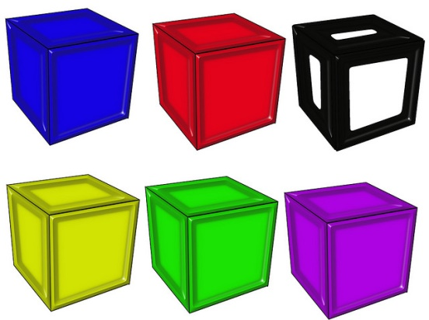
Equivalent Ratios

Slide 2
Warm Up
1). Jake paid $125 for 4 pairs of jeans. How much did he pay for each pair?
2). Kim made 15 shots in 6 minutes. How many shots did she make per minute?
3). Ike made $35 for 4 hours of work. How much did he make per hour?
4). To make 6 dozen cookies you use 8 cups of flour. How much flour is needed for one dozen cookies?
$31.25 per pair
2.5 shots per minute
$8.75 per hour
$1\frac{1}{3}$ cup of flour for 1 dozen

Slide 3
Equivalent ratios are ratios that have the same value.
Cups of Pineapple | Cups of Strawberries
1 | 2
2 | 4
4 | 8
This table shows 3 ratios that are equivalent.
$\frac{1}{2}$ = $\frac{2}{4}$ = $\frac{4}{8}$
Using the ratio 1 cup of pineapple to 2 cups of strawberries you can make as many equivalent ratios as you would like.

Slide 4
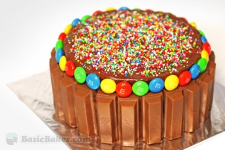
Example 1:
Dan’s mother needs 2 cakes to feed 16 children at the birthday party. How many cakes are need for 32 children? 48 children?
1 cake can serve 8 children, so you need 4 cakes for 32 children and 6 cakes for 48 children.

Slide 5
Example 1:
Dan’s mother needs 2 cakes to feed 16 children at the birthday party. How many cakes are need for 32 children? 48 children?
Cakes (c) | Children (Y)
1
2 | 16
3
 | 32
 | 48
8
24
4
6
You can use a table to help you solve the problem.
You can also figure out the equation from the table.
Every cake feeds 8 children so you multiply each cake
by 8. The equation is Y=8c.

Slide 6
Example 2: Create a table to help you solve the following problem.
Jack can run 3 miles in 18 minutes. How many miles will he run in 24 minutes? 36 minutes? What is the equation?
Miles (X) | Minute (Y)
1
2
3 | 18
 | 24
 | 36
 | Y
6
Since he runs 1 mile in 6 minutes the equation is Y=6x.
12
4
6
6x

Slide 7
Practice
1). If 3 pounds of almonds cost $15.00. How many pound can you buy for $45? What is the unit rate?
2). Fill in the table below.
3). Write the equation for the table above.
Servings (X) | 1 | 2 | 3 |  | 9
Calories (Y) |  |  | 240 | 480

Slide 8
Practice
1). If 3 pounds of almonds cost $15.00. How many pound can you buy for $45? What is the unit rate?
2). Fill in the table below.
3). Write the equation for the table above.
y = 80x
You can buy 9 pounds for $45 because the unit rate is $5 per one pound.
Servings (X) | 1 | 2 | 3 | 6 | 9
Calories (Y) | 80 | 160 | 240 | 480 | 720

Slide 9
Closure
Give an example of 2 ratios that are equivalent to the following:
6 boys for every 2 girls

