Slide 1
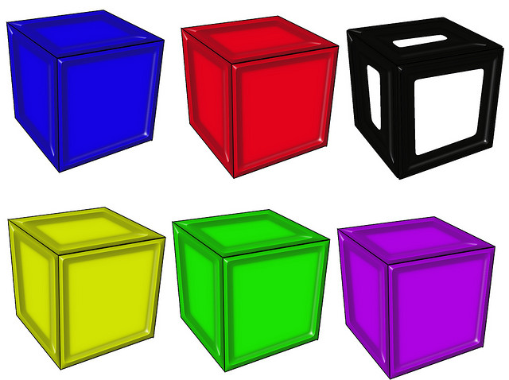
Converting Measurements

Slide 2
Warm Up
1). What could x and y represent in this table?
2). Draw a graph for the table above. What is the unit rate?
X | 1 | 2 | 3 | 4
Y | $2.50 | $5.00 | $7.50 | $10.00

Slide 3
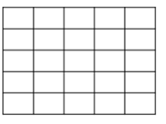
Warm Up
3). a). What does the ordered pair (2,14) represent? b). What is the unit rate? c). How many students could you expect for 7 computers?
40
30
Students
20
10
0 1 2 3 4 5
Computers

Slide 4
Warm Up
1). What could x and y represent in this table?
X could be a hamburger, and Y is the price
2). Draw a graph for the table above. What is the unit rate?
X | 1 | 2 | 3 | 4
Y | $2.50 | $5.00 | $7.50 | $10.00
10
8
6
The unit rate is $2.50 for 1
4
2
0 1 2 3 4 5

Slide 5
Warm Up
3). a). What does the ordered pair (2,14) represent? b). What is the unit rate? c). How many students could you expect for 7 computers?
a). 2 computers for 14 students
b). The unit rate is 1 computer for 7 students.
c). 49 computers for 7 students.
40
30
Students
20
10
0 1 2 3 4 5
Computers

Slide 6
A ratio can be used to compare measures of two different types.
Example 1: 10 pints is how many quarts?
1 quart = 2 pints
Conversion Factor
$$\frac{10 pints}{1}×\frac{1 quart}{2 pints}=\frac{10 quarts}{2}$$
$$\frac{10 quarts}{2}=5 quarts$$

Slide 7
Example 2: It is 27 miles to the nearest store. How many kilometers is this?
$$1 mile ≈1.6 km$$
Conversion
Factor
$$\frac{27 miles}{1}=\frac{1.6 km}{1 mile}$$
$$43.2 km$$

Slide 8
Example 3: Tom has 55 ounces of milk. How many liters is this? $1 liter ≈33.8 oz$
Conversion
Factor
$$\frac{55 ounces}{1}=\frac{1 liter}{33.8 ounces}$$
$$1.6 liters$$

Slide 9
Example 4: How many centimeters are in 6 feet. 1 inch $≈2.54 cm$
$$\frac{6 feet}{1} ×\frac{12 inches}{1 feet}=72 inches$$
Conversion factor
We first need to change the 6 feet to inches.
$$\frac{72 inches}{1}×\frac{2.54 cm}{1 inch}=182.88 cm$$
We use our conversion factor to change
inches to cm.

Slide 10
Practice
1). How many grams are in 900 milligrams?
1 gram = 1,000 milligrams
2). How many yards in 324 feet?
1 yard = 3 feet
3). How many miles in 45 km?
1 mile $≈$ 1.6 km
4). How many centimeters in 8 feet?
1 inch $≈$ 2.54 cm
$$\frac{900 mg}{1}=\frac{1 g}{1,000 mg}=0.9 grams$$
$$\frac{324 ft}{1}=\frac{1 yd}{3 ft}=108 yd$$
$$\frac{45 miles}{1}=\frac{1.6 km}{1 mile}=72 km$$
$$\frac{96 inches}{1}=\frac{2.5 cm}{1 inch}=240cm$$

Slide 11
Closure
When would you need to convert units in real life?

