Slide 1
Dividing Decimals

Slide 2
Warm Up
Rewrite each equation with the decimal in the correct place in the product.
1). $1.2×49=588$
2). $27×1.3=351$
3). $3.7×6.4=2368$
Find each product. Show work.
4). $2.41×0.17$
5). $8.7\left(0.45\right)$
6). $0.45×1.5$
58.8
35.1
23.68
0.4097
3.915
0.675

Slide 3
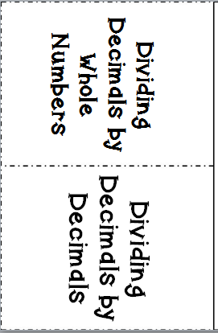
Dividing Decimals Flippable

Slide 4
6
Dividing a Decimal by a Whole Number
Example 1:
.
7 1
42.6
6
Move the decimal straight up.
42
06
6
0
Now divide as with whole numbers.

Slide 5
6
Dividing a Decimal by a Whole Number
Example 2:
.
0 12
12
1.44
12
24
24
0

Slide 6
Dividing Decimals by Decimals
Example 1:
$$12÷(1.6)$$
Multiply the dividend and divisor by 10 to move the decimal out of the divisor. Then divide as if you were dividing by a whole number.
7.5
16 120.0
-112
80
80
0
Divisor
Dividend

Slide 7
Dividing Decimals by Decimals
Example 2:
$$7.56÷2.4$$
3.15
240 756
720
360
240
1200
1200
0

Slide 8

Practice
Solve each problem.
1). $8.28÷4.6$
2). $18.48÷1.75$
3). $4÷1.25$
4). $1.25÷5$
1.8
10.56
3.2
0.25

Slide 9

C
Closure
How are these problems alike? Different? Solve them.
$4.27÷0.7$ $427÷7$
6.1
61

