Slide 1
Adding and Subtracting Fractions

Slide 2
Warm Up
Change to a mixed number.
$\frac{26}{11}$2. $\frac{35}{6}$
Change to an improper fraction.
3. 4 $\frac{3}{8}$ 4. 6 $\frac{1}{3}$
5 $\frac{5}{6}$
2 $\frac{4}{11}$
$\frac{35}{8}$
$\frac{19}{3}$

Slide 3
Addition and Subtraction of Fractions Foldable
Fractions with the Same Denominator
Fractions with Different Denominators

Slide 4
Fractions with the Same Denominator
To add or subtract like denominators, add or subtract the numerators and write the answer over the denominator. Simplify if necessary.
Example 1: $\frac{3}{7}$ + $\frac{2}{7}$ = $\frac{5}{7}$

Slide 5
Fractions with Different Denominators
To add or subtract fractions with different denominators rename the fraction using a common denominator. Then add or subtract as with fractions with the same denominator.

Slide 6
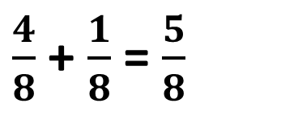
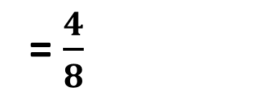
Example 2: $\frac{1}{2}$ + $\frac{1}{8}$
You need to get a common denominator by finding the LCM (also called LCD – least common denominator) of 2 and 8.
LCD is 8. Create equivalent fractions with a denominator of 8.
$\frac{1}{2}$
x 4
= $\frac{4}{8}$
$\frac{4}{8}$ + $\frac{1}{8}$ = $\frac{5}{8}$
x 4

Slide 7



Practice
Add or subtract
$\frac{5}{6}$ + $\frac{1}{6}$
$\frac{1}{6}$ + $\frac{3}{8}$
$\frac{10}{11}$ - $\frac{2}{3}$
$\frac{7}{10}$ - $\frac{1}{4}$
1
$\frac{13}{24}$
$\frac{8}{33}$
$\frac{9}{20}$

Slide 8

Closure
I bought $\frac{3}{4 }$lb of ham. I need $\frac{4}{5}$lb of ham to make sandwiches for my family. How much more ham do I need?
$$\frac{1}{20}$$

